Slide 1

Training
in Medical Specialty (TMS)

Slide 2
Agenda
What Is TMS?
Qualifying Programs
Financial Benefits
Health Insurance Benefits
Servicemembers’ Group Life Insurance (SGLI)
Employer Support of the Guard and Reserve (ESGR)
Other Reserve Benefits
Eligibility
Obligation
Obligation Calculation
While in TMS
2

Slide 3

What is TMS?
TMS is a Navy Selected Reserve (SELRES) Direct Commission Officer (DCO) Program designed to provide financial and other incentives for medical and dental residency/fellowship programs.
Medical Corps and Dental Corps critical skill specialties will be considered for TMS via the professional review board. The Bureau of Medicine and Surgery, Reserve Affairs Officer is the approval authority for TMS. Examples of specialties are neurosurgery, orthopedic surgery and oral maxillofacial surgery.
Participants perform a minimum of four Inactive Duty Trainings (drills) per quarter (physically show up to a Navy Operational Support Center twice per year).
All pay and allowances are received just like a regular Drilling Reservist.
Time in training counts as a regular good year toward retirement.
3

Slide 4
What is TMS?
U.S. Navy Reserve Direct Commissioning Officer (DCO)* program and drill option
Allows health care providers enrolled in an eligible medical/dental residency or fellowship program an opportunity to:
Commission as a Selected Reserve** Medical or Dental Corps Officer
Participate in a minimal time commitment until program completion: four drill periods per quarter, which may be done virtually
Transition to fully participating as a U.S. Navy Reserve Medical or Dental Corps Officer upon program completion
Earn Reserve drill pay, training credit and retirement points
Receive financial, health care and other incentives
*Direct Commission Officers: civilians who commission as an officer in the U.S. Navy Reserves
**Selected Reserves (SELRES): active participants in the U.S. Navy Reserves who complete the requirements of satisfactory participation including:
Drill weekend once a month (four drill periods in one weekend)
Two weeks of Annual Training (AT)
Annual physical fitness test
Remain medically ready and qualified
3

Slide 5
QUALIFYING PROGRAMS
Any residency or fellowship program in a qualifying specialty
--
Some currently eligible programs include:
Anesthesia
General Surgery
Cardiothoracic Surgery
Colorectal Surgery Peri/
Vascular Surgery Trauma
Surgery Neurosurgery
Orthopedic Surgery
Oral Maxillofacial Surgery
Emergency Medicine
Family Medicine
Psychiatry
Radiology
Internal Medicine and Associated Specialties Including:
Critical Care
Cardiology
Infectious Disease
Nephrology
Pulmonology
3

Slide 6

Financial Benefits
Those in a critical specialty are eligible for:
Estimated monthly stipend of $2,728.00 estimated (adjusted annually)
$250,000 student loan repayment (must draw stipend if you desire loan repayment)
The max Health Professions Loan Repayment Program (HPLRP) benefit ($250,000) is paid out in annual installments of $40,000 over six years, and the final installment after year seven is $10,000
Three-year residency earning potential, stipend only: $98,200
Total earning potential with stipend and Loan Repayment Program (LRP): $218,000
Does not include drill/annual training base pay
4

Slide 7
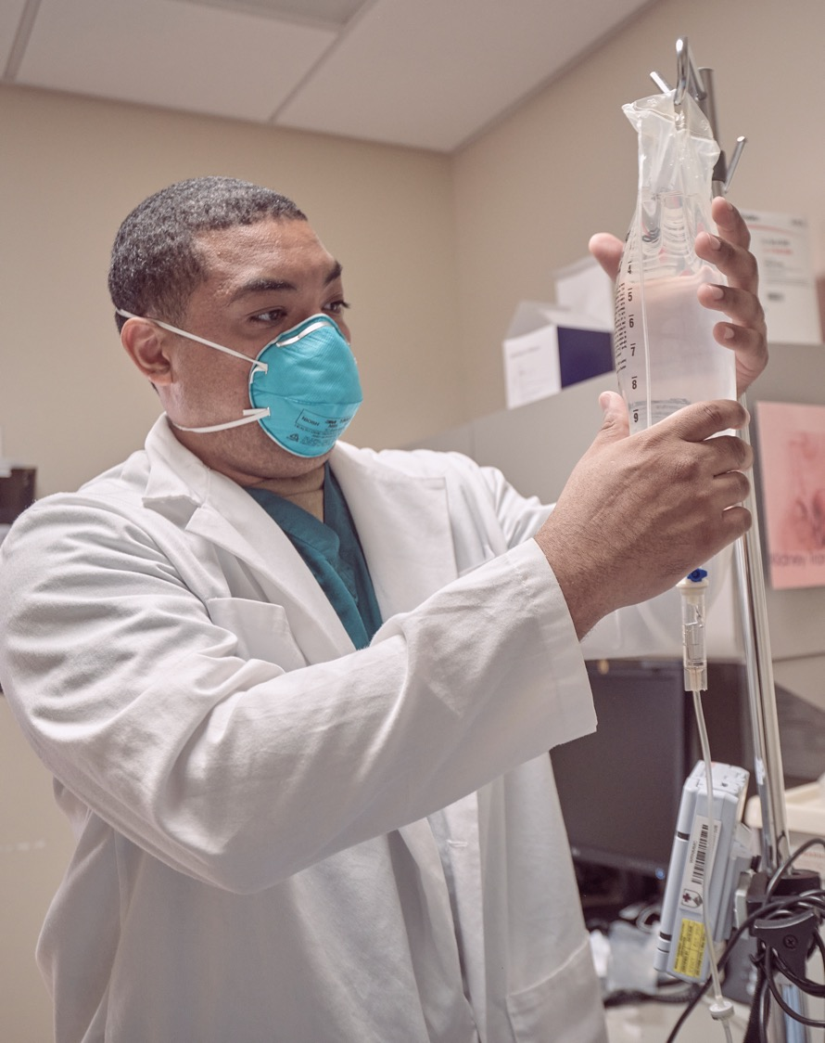
Health Insurance
TRICARE Reserve Select: Low-cost medical coverage
Member only: $48.47/month
Member and Family: $239.69/month
https://tricare.mil/Costs/HealthPlanCosts/TRS
Deductibles:
Sponsor Rank E4 and below: $60 per individual, but no more than $121 per family
Sponsor Rank E5 and above: $182 per individual, but no more than $365 per family
Copays and Cost Shares: https://tricare.mil/Costs/HealthPlanCosts/TRS/CostShares_US
5

Slide 8

Servicemembers’ Group Life Insurance (SGLI)
SGLI is offered to all Selected Reservists with up to $500,000 of available coverage
Monthly premium: $30
Dependents are also eligible for SGLI coverage
Spouse: up to $100,000 (monthly premium age-dependent, range $4.50/< 35 years old to $45/> 60 years old)
Children: up to $10,000 each
6

Slide 9
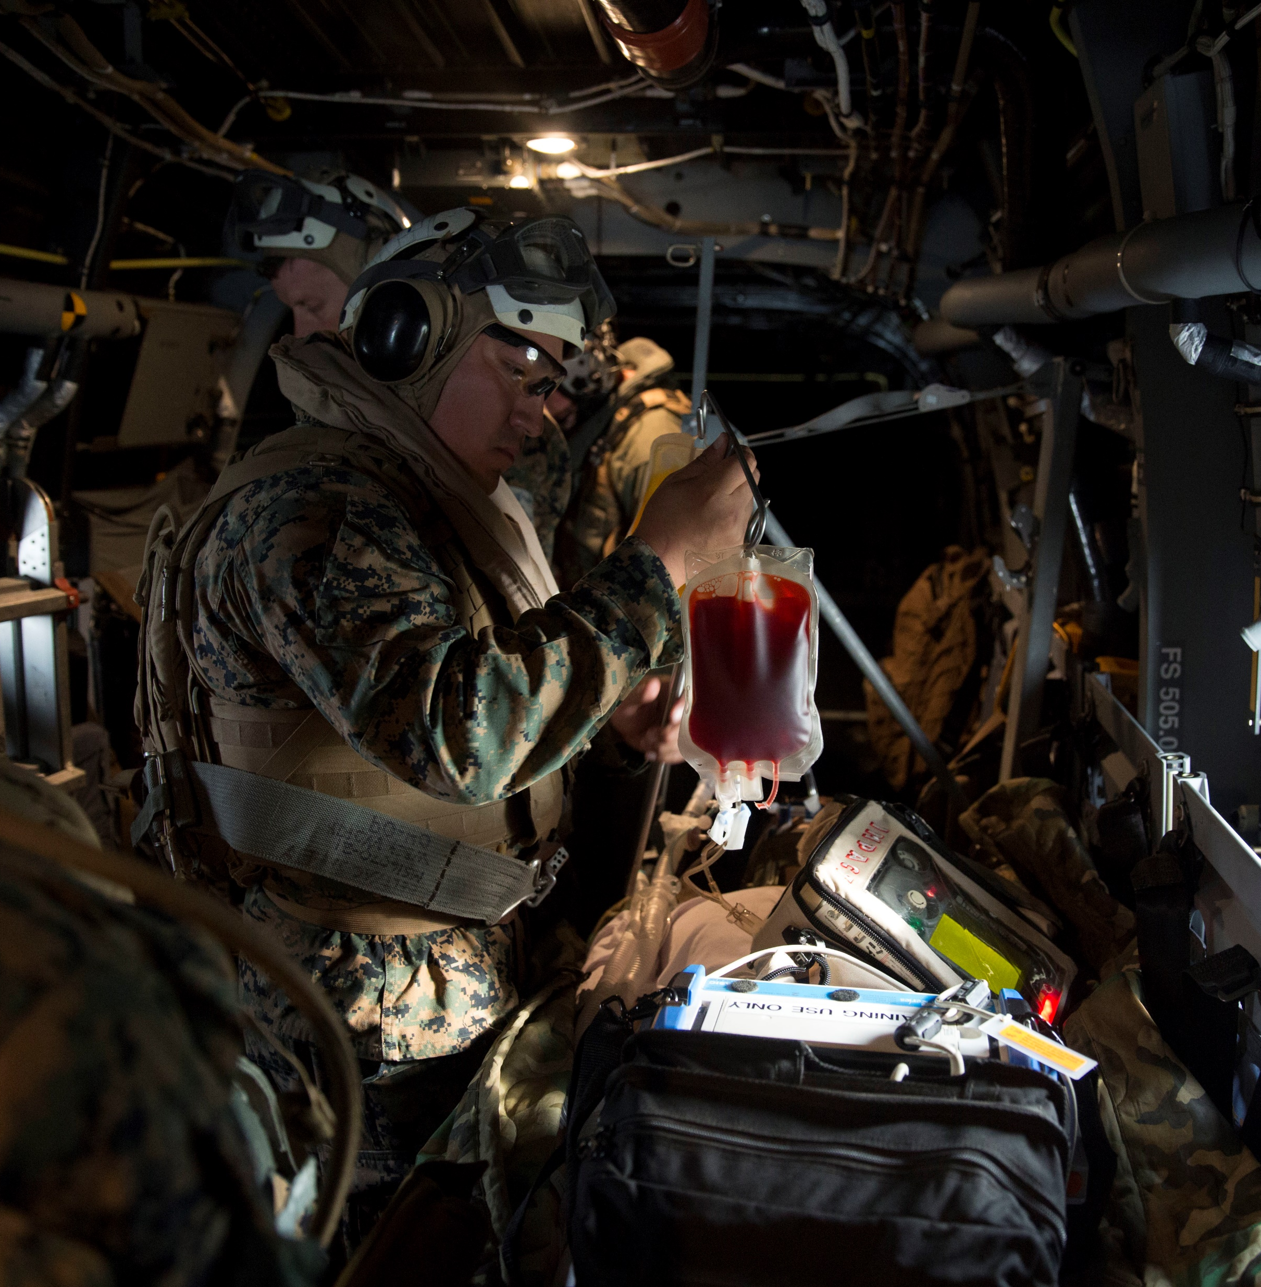
Employer Support Of The Guard And Reserve (ESGR)
USERRA (RE-EMPLOYMENT ACT OF 1994)
Protects job rights
Prohibits employer discrimination
7

Slide 10

Other Reserve Benefits
Full Morale, Welfare and Recreation (MWR) Privileges
Golf, gym, RV campground, theater, etc.
Any base nationwide
Commissary and Exchange Privileges
Space “A” Availability for Air Travel
8

Slide 11

Eligibility
Must be a U.S. citizen
Must be accepted for enrollment in an American Association of Colleges of Osteopathic Medicine (AACOM), American Medical Association (AMA), Accreditation Council for Graduate Medical Education (ACGME) or American Osteopathic Association (AOA) program
Must be a full categorical match into an ACGME-accredited residency or fellowship
Training must be completed before age 42*
*Maximum age may be higher with approved waiver
9

Slide 12
Obligation
TMS Alone
Applicant incurs a three-year SELRES obligation regardless of the number of years in residency/fellowship that they were approved
TMS and Stipend
Applicant incurs one year for every six months or any portion of a month
Examples:
Stipend paid for two years; SELRES obligation is four years
Stipend paid for two years and two months; SELRES obligation is five years
TMS, Stipend and HPLRP
Obligation is calculated the same as TMS and Stipend. However, the obligation for the stipend WILL NOT begin until the residency or fellowship training is completed or the HPLRP max benefit is paid, stopped, or suspended, whichever occurs last.
10

Slide 13
OBLIGATION
Calculation
YEARS IN RESIDENCY | TMS | TMS AND STIPEND | TMS, stipend and HPLRP
1 YEAR | 3 YEARS | 3 YEARS | 5 YEARS
2 YEARS | 3 YEARS | 4 YEARS | 5 YEARS
3 YEARS | 3 YEARS | 6 YEARS | 6 YEARS
4 YEARS | 3 YEARS | 8 YEARS | 8 YEARS
5 YEARS | 3 YEARS | 10 YEARS | 10 YEARS
6 YEARS | 3 YEARS | 12 YEARS | 12 YEARS
7 YEARS | 3 YEARS | 14 YEARS | 14 YEARS
8 YEARS | 3 YEARS | 16 YEARS | 16 YEARS
11

Slide 14

While in TMS…
Will never be pulled out of residency training for deployment
It allows for a two-week Annual Training (AT) while in residency or fellowship should the member desire
Officer Development School shall be arranged prior to the start of drilling or as a first Annual Training within the first year in the Selected Reserve force
12

Slide 15
CONTACT INFORMATION
[Name]
[Title]
[Email]
[Office number]
[Cell number]
13

